Slide 1
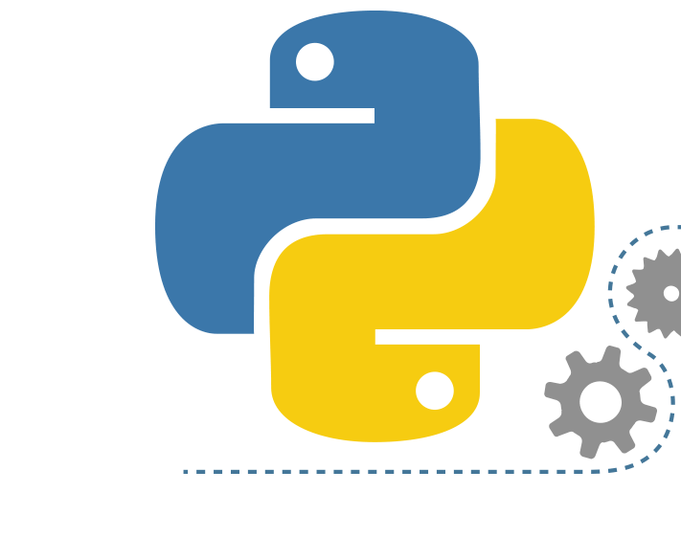
Dependency Management in Python

Slide 2
PyPI(Python Package Index)
PyPI is the official repository for Python packages, providing a centralized location for developers to publish and share their Python software.
It hosts a vast collection of open-source libraries, modules, and applications that can be easily downloaded and used by Python developers.
PyPI allows developers to share their code with the Python community and encourages collaboration and reuse of code.
It provides a platform for versioning and distribution of packages, ensuring that users can access specific versions of software.
PyPI supports package metadata, including descriptions, author information, documentation links, and licensing details, which helps users make informed decisions when selecting packages.

Slide 3
pip (Python Package Installer)
Pip is the default package manager for Python, designed to install and manage packages from PyPI.
It simplifies the process of installing and managing external libraries or modules, making it easy to incorporate third-party code into Python projects.
Pip resolves and installs dependencies automatically, ensuring that all required packages are installed correctly.
It supports various installation options, such as installing specific versions of packages, upgrading packages, uninstalling packages, and managing virtual environments.
Pip integrates well with Python's package management ecosystem and is widely used by developers for package installation and maintenance.

Slide 4
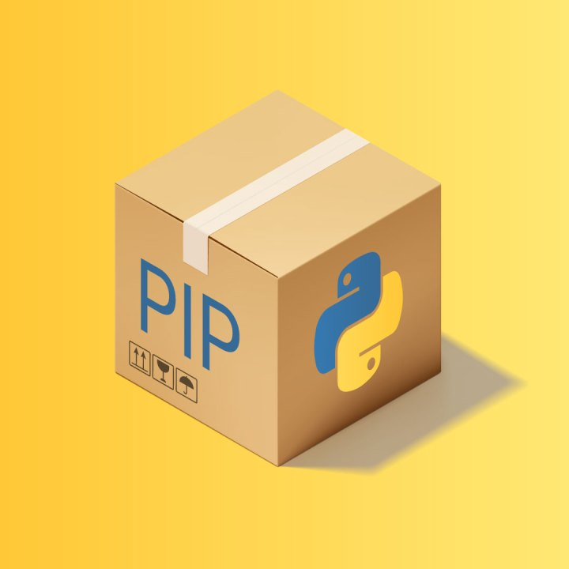
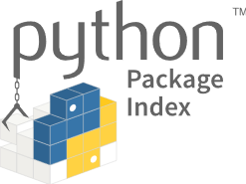
Both Pip and PyPI are essential components of the Python ecosystem, working together to facilitate the discovery, distribution, and installation of Python packages. PyPI provides the repository of packages, while pip acts as the tool to manage and install those packages from PyPI.

Slide 5

Install
Install a package:
pip install package_name
Upgrade
Upgrade a package:
pip install --upgrade package_name
Uninstall
Uninstall a package:
pip uninstall package_name
Show
Show information about a package:
pip show package_name
List
List all installed packages:
pip list
Search
Search for a package:
pip search search_query
Freeze
Freeze installed packages to a requirements file:
pip freeze > requirements.txt
Install
Install packages from a requirements file:
pip install -r requirements.txt

Slide 6
Dependency Management
Dependency management is the process of handling and organizing external libraries, modules, or packages required by a software project.
It involves identifying, acquiring, and maintaining the necessary dependencies to ensure the project functions correctly.
Dependency management resolves conflicts, manages version compatibility, and facilitates code reuse and collaboration.
It simplifies development, enhances code maintainability, and supports scalability and security updates.
Dependency management ensures consistent and reliable software by managing the interdependencies between different components of a project.

Slide 7
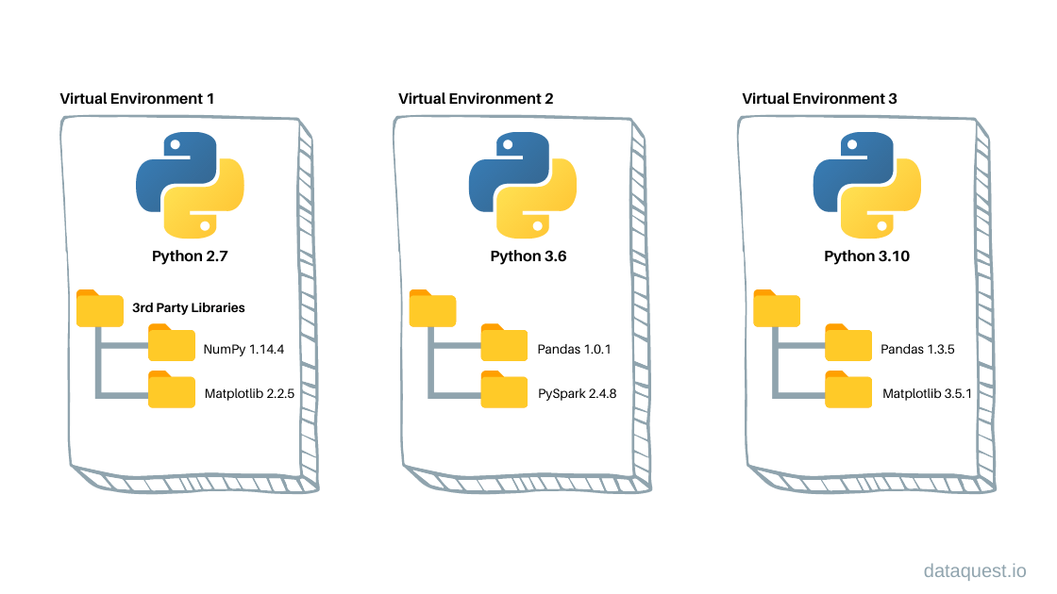
Isolated Environments

Slide 8
Virtualenv
Virtualenv is a tool in Python that creates isolated environments where you can install and manage project-specific dependencies. It works by creating a self-contained directory that contains a separate Python interpreter and its own set of installed packages.

Slide 9
Virtualenv Commands
Installation:
Creating a Virtual Environment:
virtualenv myenv
Activating the Virtual Environment:
Windows - myenv\Scripts\activate
MacOS/Linux - source myenv/bin/activate
Deactivating the Virtual Environment
deactivate
pip install virtualenv

Slide 10
Virtualenv
Virtualenv creates isolated Python environments for projects, ensuring dependency separation and preventing conflicts.
It allows for reproducible environments by capturing the exact set of dependencies and their versions.
Virtualenv simplifies dependency installation within the isolated environment, keeping project-specific dependencies separate from the global Python environment.
It is portable and compatible, working across different platforms and facilitating consistent development and deployment environments.
Virtualenv integrates with tools like pip and requirements.txt, enhancing dependency management capabilities within the isolated environment.

